Slide 1

MERN Stack
Under the Guidance of Ms. Amita Mishra By, Professor, CSE Department. Thani Chandu
198R1A05N1

Slide 2
Introduction
What is MERN Stack ?
Classification of MERN Stack
Why only tongue.
Parts of devices.
Working of device.
Application.
Advantages and Disadvantages
conclusion

Slide 3
What is MERN Stack?
frameworks available and is prevalent in MERN stack is an acronym for a full stack JavaScript framework consisting of MongoDB, Express.js, React, and Node.js. It is among the most common full stack eb development projects utilizing JavaScript.

Slide 4
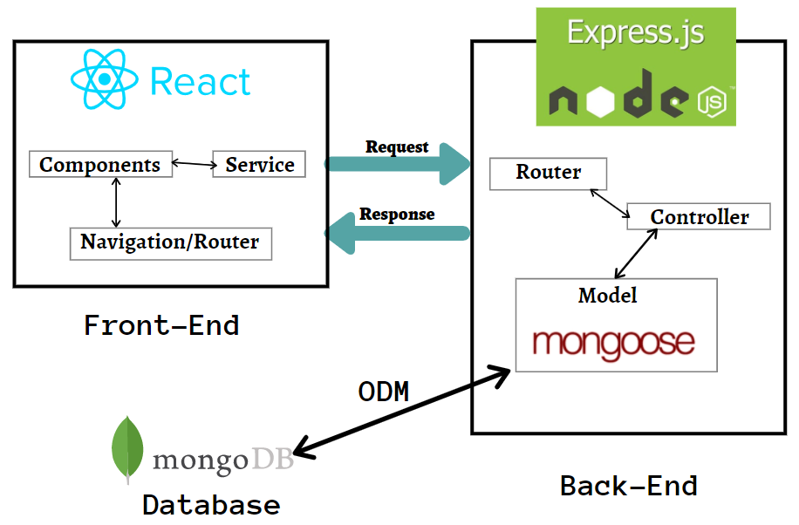
MERN is only one of several full stack development frameworks that coders can learn and use, so students will want to consider the kinds of projects they are working on when selecting the first framework to study.

Slide 5
Why does the device placed on the tongue?
Other parts of the body, such as the back, were not sufficiently sensitive. The fingertips were sensitive enough, but people wanted full use of their hands to grip a cane or to grab objects. Placing the device on the tongue inside the mouth frees the hands to interact with the environment, Plus, the device can be hidden in the mouth. The key to the device may be its utilization of the tongue, which seems to be an ideal organ for sensing electrical current. Saliva there functions as a good conductor.

Slide 7
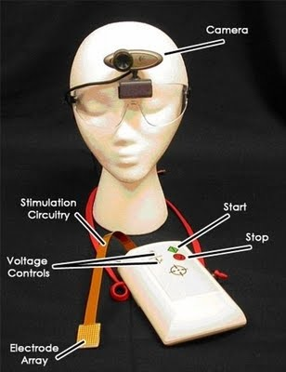
Parts of device.
Camera
Electrode array
Stimulation circuit
Voltage controller
Buttons

Slide 8
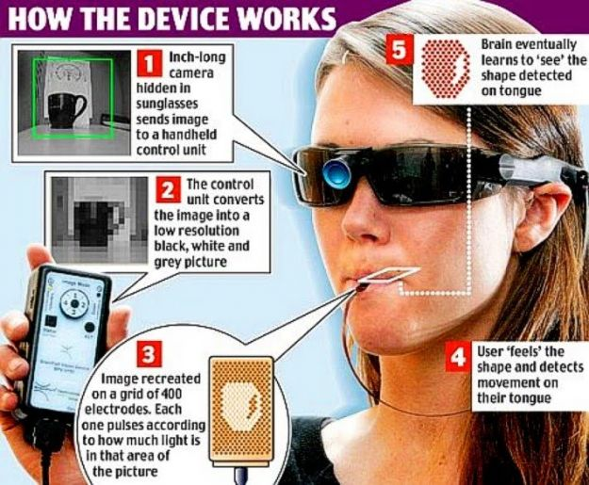
Working of device.
The working of the BrainPort device can be divided into 3 stages.
Camera to CPU: Camera captures the images and sends them to the CPU.
CPU to tongue: CPU converts the images into a pattern of electronic impulses and sends them to the electrode array placed atop the tongue.
Tongue to Brain: These impulses are then sent to the sensory cortex of the brain.

Slide 9
Applications
Interpreted by blind people using device APPLICATIONS OF BRAIN PORT DEVICE:
One of the applications which has been Commercialized is providing balance information for people with balance disorders. This is a simple form of sensory substitution, in which the tongue is used to present information from an artificial balance Sensor.
Another application is providing directional or navigational information for people .
A third, more ambitious application would be providing very crude visual information through the tongue for persons who are completely blind.
A fourth application would be providing tactile feedback to the human operators of robots used for various tasks. For example, UW professor Nicola Ferrier is developing a robot controlled by the tongue of persons With quadriplegia which could incorporate touch sensors into its gripper, relaying the touch information back to the users tongue

Slide 10
Advantages
BrainPort device does not replace the sense of sight, it adds to other sensory experiences to give users information about the size, shape, and location of objects.
Users can operate it independently with a hand-held controller.
A pair of sunglasses wired to an electric “lollipop” helps the visually impaired regain optical sensations via a different pathway Therefore device is like normal sunglasses hence it does not look bad.
It uses a rechargeable battery like in normal cell phones.

Slide 11
Disadvantages
This technology can’t be adapted to work on senses the brain doesn’t already have.
The BrainPort device requires training the brain incrementally using daily practice sessions.
When it comes to market its cost is around $10,000 so it cannot be afforded by common people.
Occasionally it will produce weak metallic taste sensations, a minor side effect. We have never observed any kind of tissue irritation with the gold-plated electrodes.

Slide 12


Slide 13
Conclusion
The Brain port vision Devise allows users to directly and independently perceive the environment in a novel way.
There is a hope that this device can make a session difference for patients whose sight canbe replaced.
Thus we hope that blind people can also see this colourful world virtually by using this brain port device.

Slide 14
Thank you.

